Slide 1
Investigating the Genetic Difference Between Gleason 3+4 and Gleason 4+3 Cases
Desiree Wilson

Slide 2
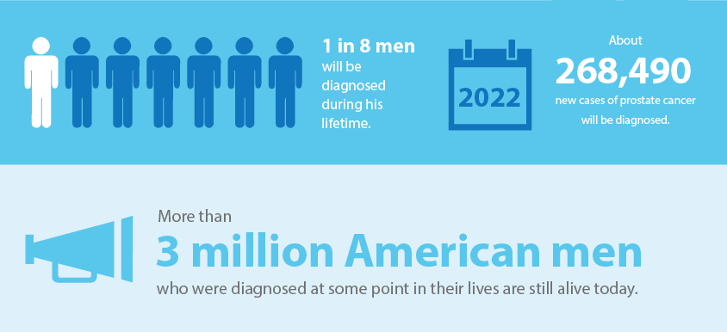
Background – Prostate Cancer Incidence
https://www.cancercenter.com/cancer-types/prostate-cancer/diagnosis-and-detection

Slide 3
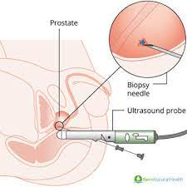
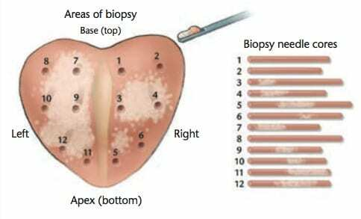
Background – How Prostate Cancer is Diagnosed
https://www.bensnaturalhealth.com/blog/side-effects-prostate-biopsy/; https://georgiaradiationtherapy.com/prostate-cancer-treatment/prostate-biopsy-pathology-report

Slide 4
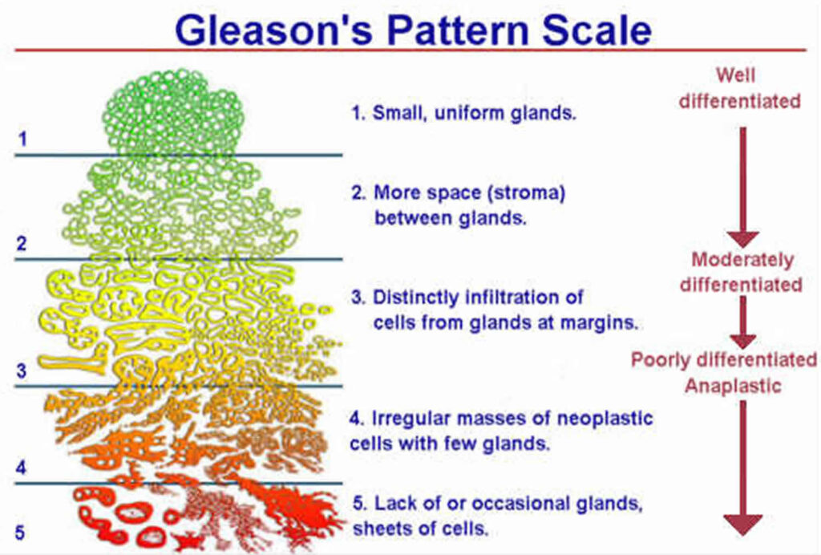
Background – Gleason: A Prognostic Indicator
https://koelis.com/what-is-the-gleason-score/

Slide 5
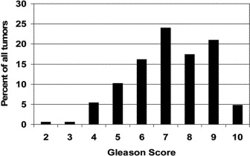
Background – Gleason Is Suboptimal
THOMPSON, K. E., HERNÁNDEZ, J., Canby-Hagino, E. D., TROYER, D. & Thompson, I. M. PROGNOSTIC FEATURES IN MEN WHO DIED OF PROSTATE CANCER. The Journal of Urology 174, 553–556 (2005).

Slide 6
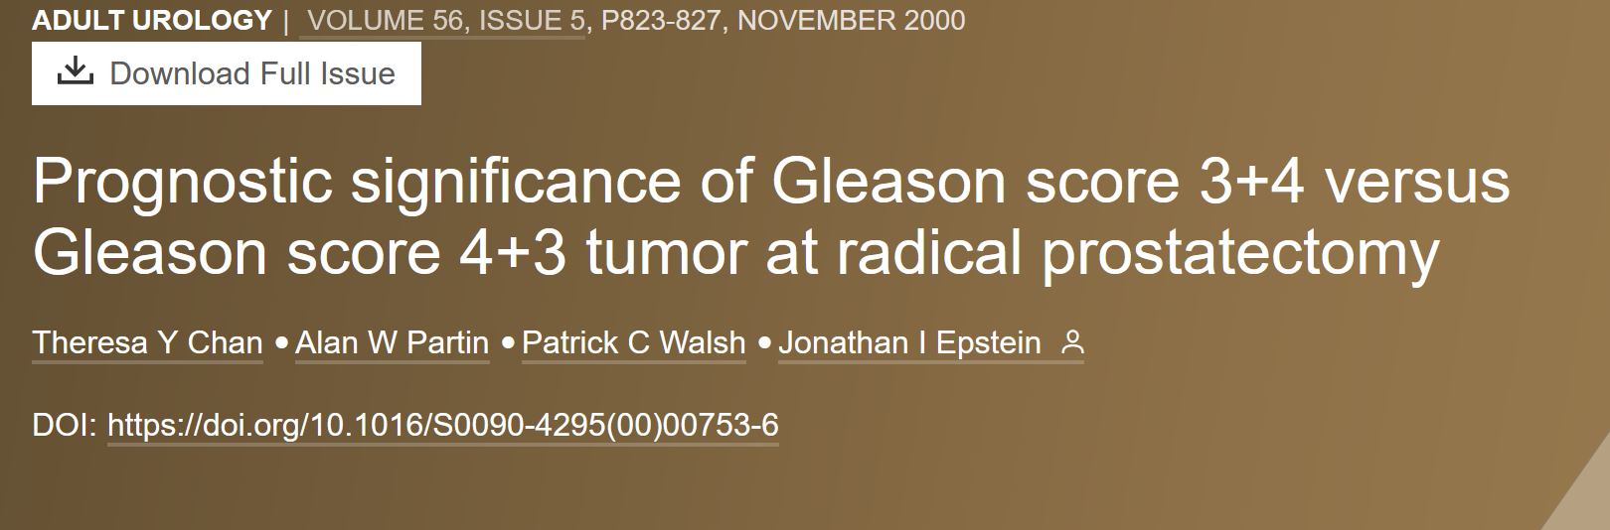
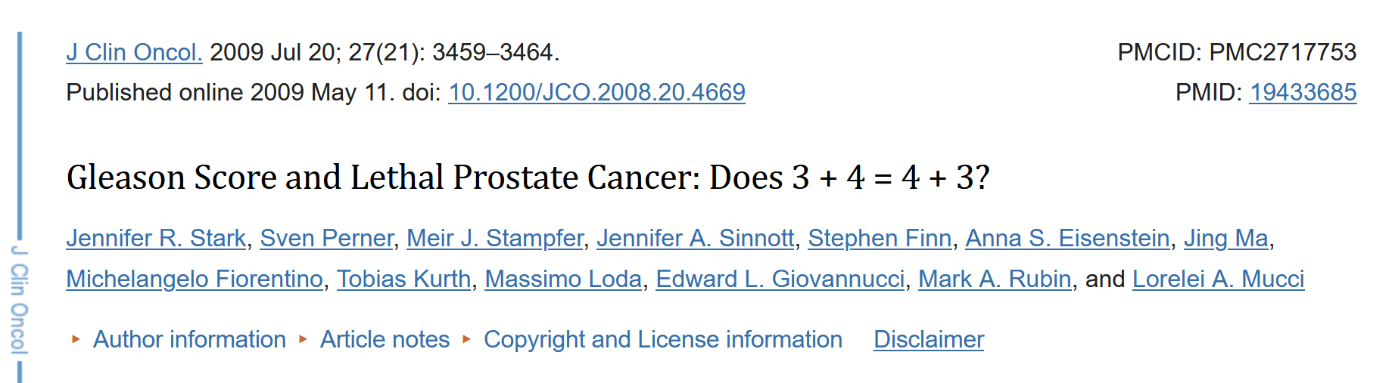
Background – Gleason 3+4 vs Gleason 4+3
It’s been known for quite some time Gleason 3+4 is not the same as Gleason 4+3.
The goal for many physicians is to identify metastatic prostate cancer cases at the time of diagnosis.

Slide 7
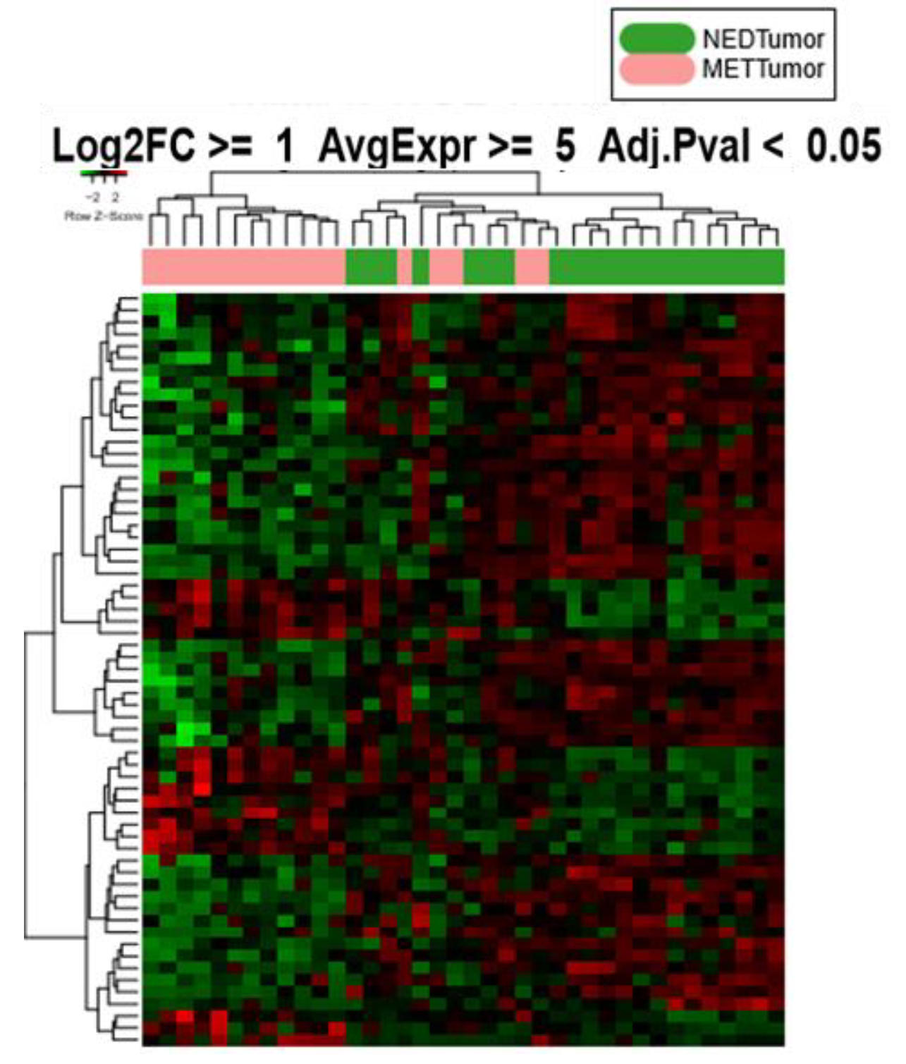
Background – Identification of Genes Associated with Prostate Cancer Prognosis
During my dissertation, I performed gene expression analysis on RNA samples collected from men who underwent a radical prostatectomy. We then followed these men for 10 years to see if they developed metastatic disease (METTumor) or if they remained in remission (NEDTumor).

Slide 8
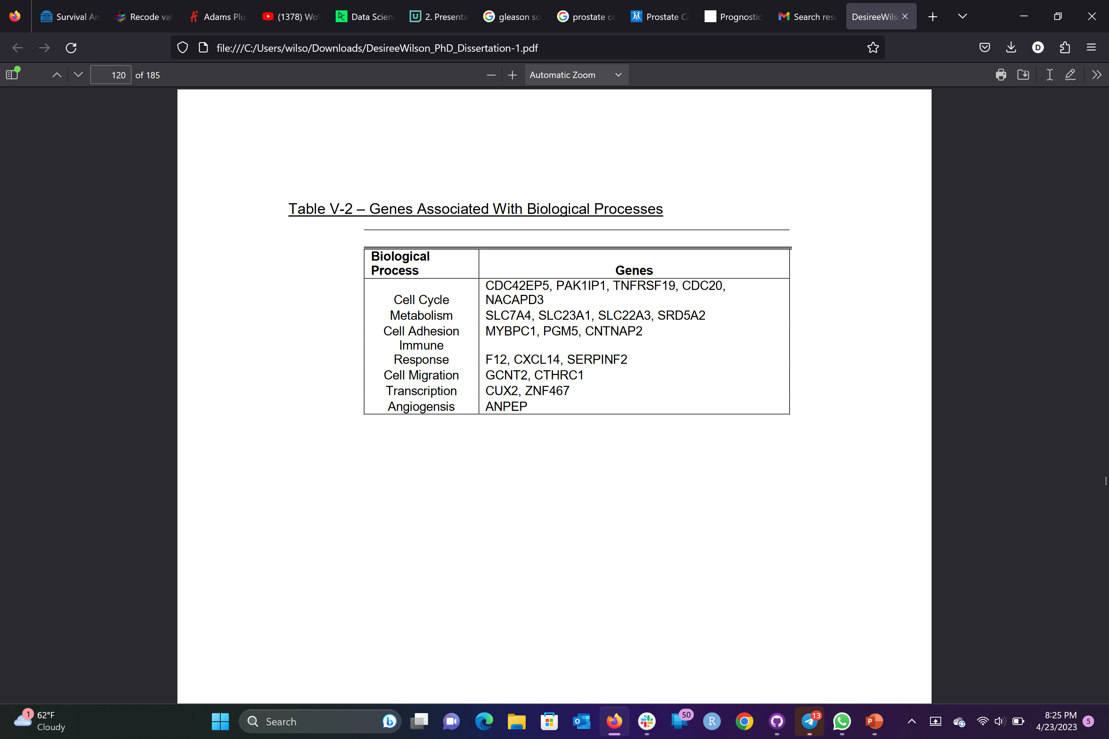
Background – Twenty-Nine Genes Associated with Prostate Cancer Prognosis
These are the genes I found to be significantly different between no evidence of disease (NEDTumor) and metastatic disease (METTumor).

Slide 9

Background – Indolent vs Aggressive Prostate Cancer
Goal: to distinguish between indolent and aggressive prostate cancer.
Aggressive Treatment
Do Not Treat
Do Not Treat

Slide 10
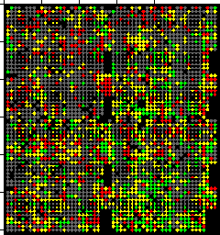
Project Introduction
Test if genes distinguish between Gleason 3+4 and Gleason 4+3 cases
SABOR samples from my PhD dissertation
Dataset GSE70769
To accomplish this, I want to test the expression of 29 genes to see if they are associated with Gleason poor outcome (Gleason 4+3) in an independent dataset.

Slide 11
Methods
Differential gene expression analysis using LIMMA
Survival analysis

Slide 12
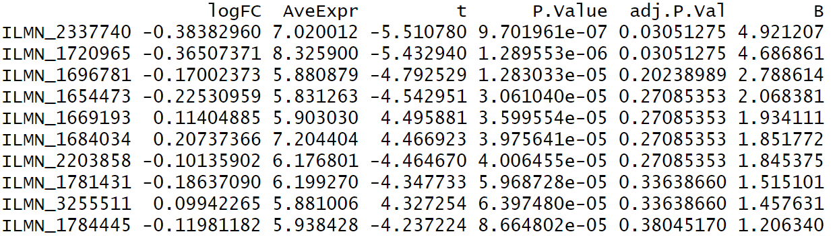
Results – Two Probes Differentially Expressed Between Gleason 3+4 and Gleason 4+3 Cases
Unfortunately, the fold change is too small; log2 fold change needs to be at least 1

Slide 13
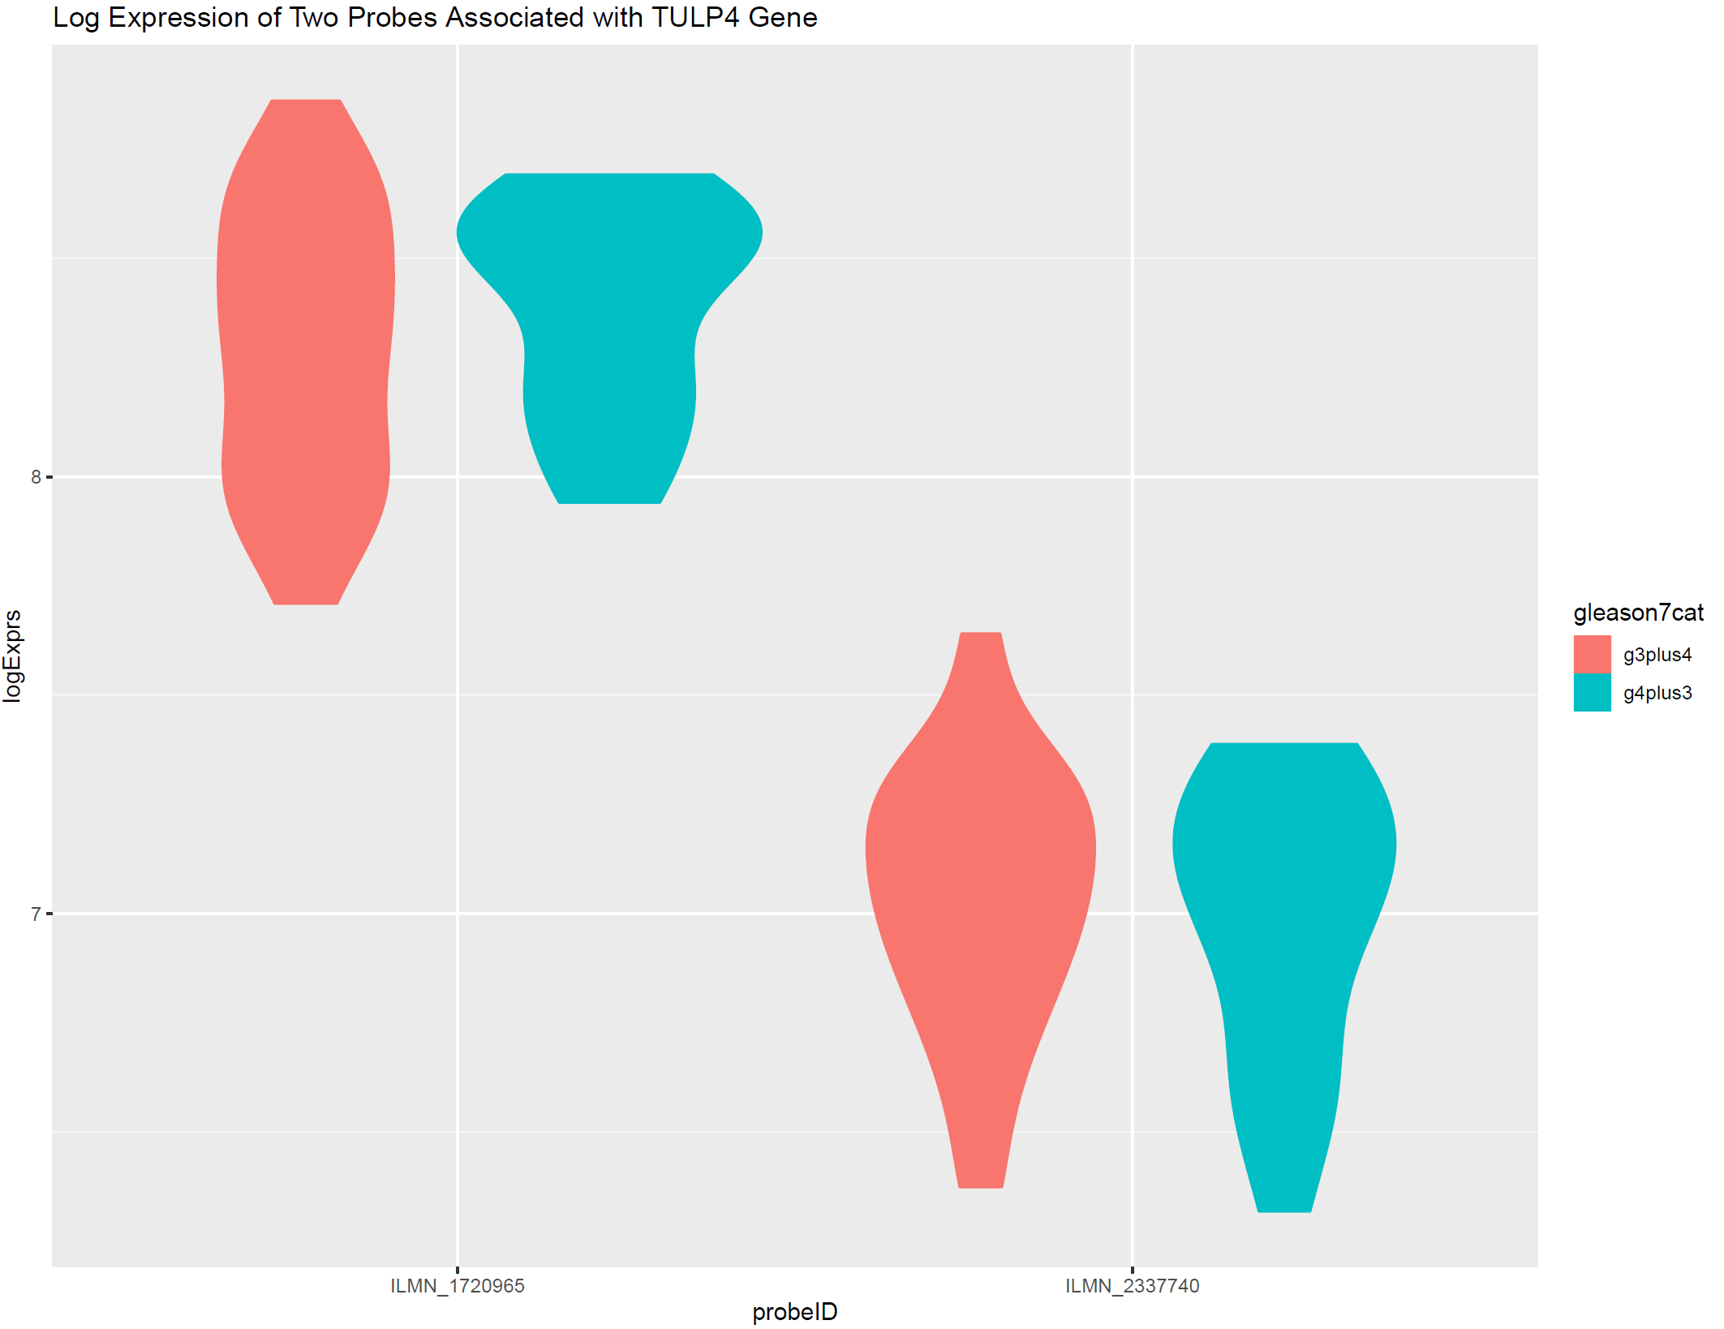
Results – Boxplot of the Two Probes Differentially Expressed Between Gleason 3+4 and Gleason 4+3 Cases

Slide 14
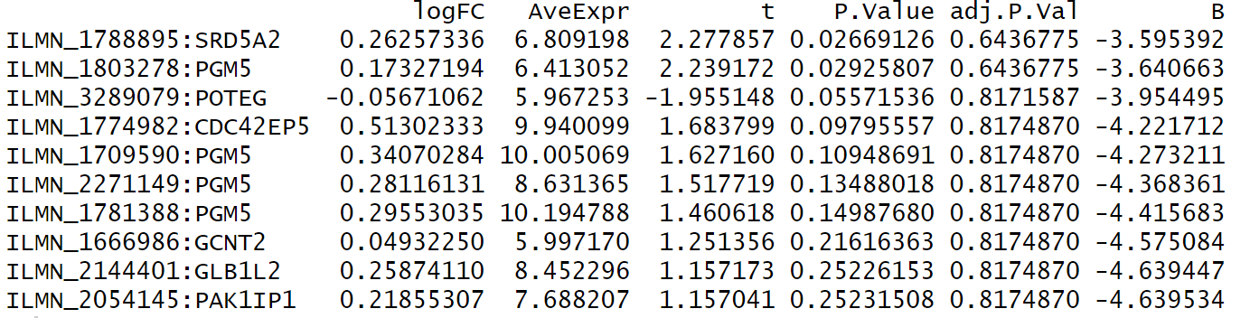
Results – None of the Probes Are Differentially Expressed Between Gleason 3+4 and Gleason 4+3 Cases

Slide 15
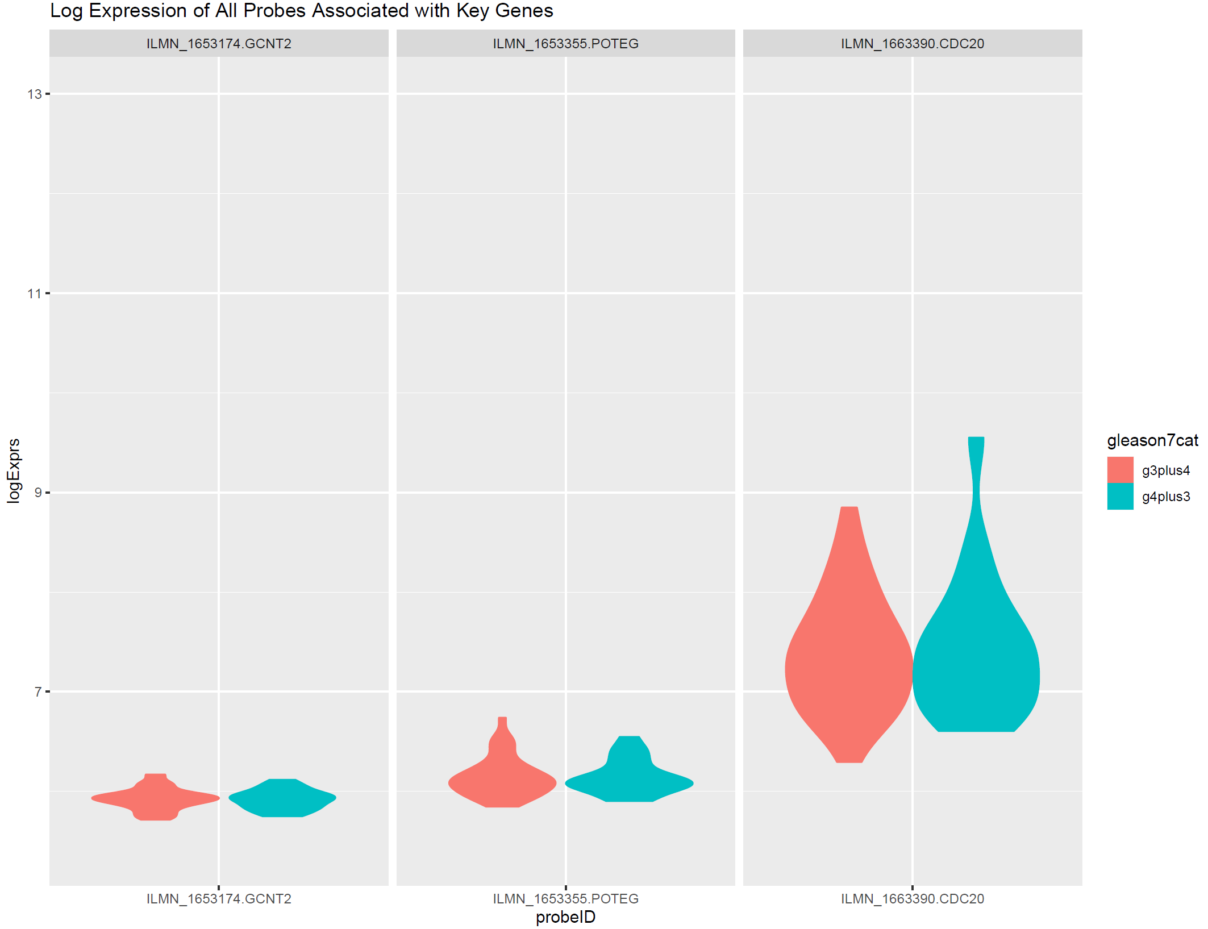
Results – None of the 29 Genes are Differentially Expressed Between Gleason 3+4 and Gleason 4+3 Cases

Slide 16
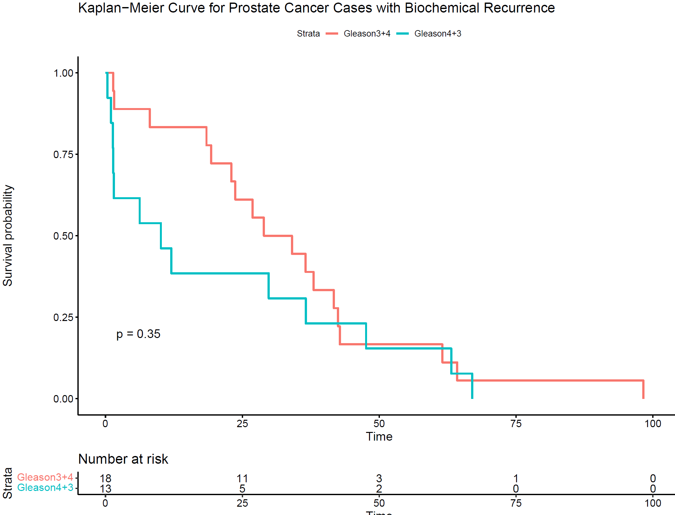
Results – Gleason 3+4 and Gleason 4+3 Cases Have the Same Time to Biochemical Recurrence

Slide 17
Summary
Two probes were differentially expressed between Gleason 3+4 and Gleason 4+3, ILMN_1720965 and ILMN_2337740, both associated with gene TULP4
The fold change is too small
TULP4 is involved in protein ubiquitination
None of the 29 genes were differentially expressed between Gleason 3+4 and Gleason 4+3
Gleason 3+4 cases do not have a significantly different time to biochemical recurrence compared to Gleason 4+3

Slide 18
Conclusions
Based on the
Next step: power analysis
I should have done a power analysis (looking through the literature to figure out the effect size) to determine how many samples I needed prior to the analysis
After power analysis, gather more samples and rerun the analysis again.

Slide 19

http://www.fastweb.com/uploads/article_photo/photo/2035804/crop635w_college-choice-questions2.jpg

